Slide 1
SOFTWARE ENGINEERING
TOPIC : COUPLING AND COHESION
CLASS: III BCA A
STAFF NAME: T.R.B.VIDHYA M.S.I.T.,M.Phil.,m.c.a.,
ASSISTANT PROFESSOR
DEPARTMENT OF COMPUTER SCIENCE
SIGC,TRICHY.

Slide 2
INTRODUCTION
SOFTWARE:
Computer programs, procedures and possibly associated documentation and data pertaining to the operation of a computer system.
SOFTWARE ENGINEERING:
It is concerned with all aspects of software production.

Slide 3
SOFTWARE DEVELOPMENT
LIFE CYCLE MODEL
A series of identifiable stages that a software product undergoes during its lifetime.
1) Planning.
2) Requirement analysis and specification.
3) Design.
4) Coding.
5) Testing.
6) Maintenance.

Slide 4
COUPLING AND COHESION

Slide 5
INTRODUCTION
The purpose of Design phase in the Software Development Life Cycle is to produce a solution to a problem given in the SRS (Software Requirement Specification) document.
The output of the design phase is Software Design Document (SDD).
Basically, design is a two-part iterative process.
First part is Conceptual Design that tells the customer what the system will do.
Second is Technical Design that allows the system builders to understand the actual hardware and software needed to solve customer’s problem.

Slide 6
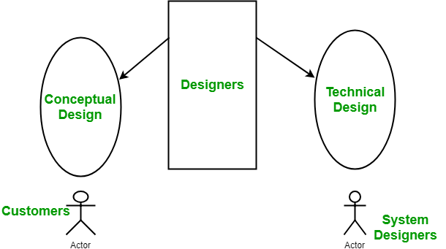
FIGURE

Slide 7
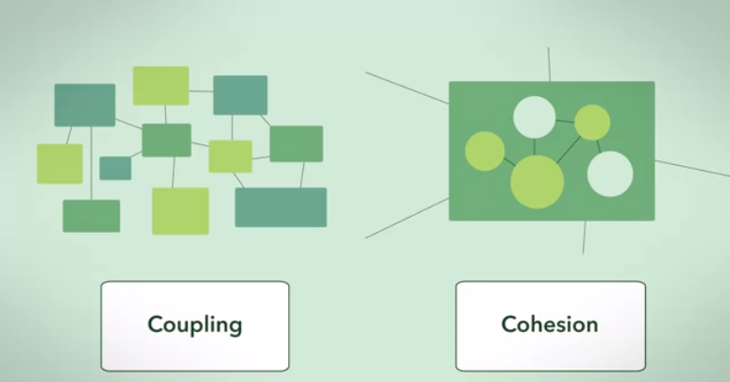
COUPLING AND COHESION DIAGRAM

Slide 8
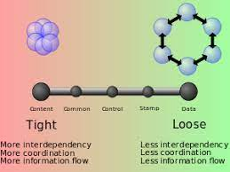
COUPLING
In software engineering, Coupling is the measure of the degree of interdependence between the modules.
A measure of how closely connected two routines or modules.
A good software will have low coupling.

Slide 9
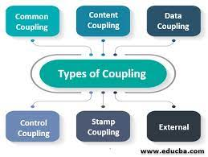
TYPES OF COUPLING

Slide 10
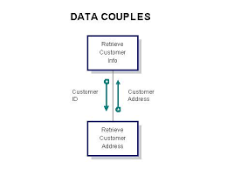
DATA COUPLING
To communicate by passing only data, then the modules are said to be data coupled. This is an best form of coupling.
Example-customer billing system.

Slide 11
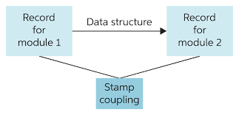
STAMP COUPLING
In stamp coupling, the complete data structure is passed from one module to another module.

Slide 12
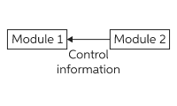
CONTROL COUPLING
If the modules communicate by passing control information, then they are said to be control coupled.

Slide 13
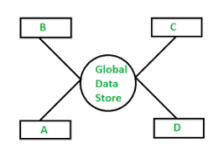
COMMON COUPLING
Common coupling (also known as Global coupling) occurs when two modules share the same global data (e.g., a global variable).
Changing the shared resource might imply changing all the modules using it.

Slide 14
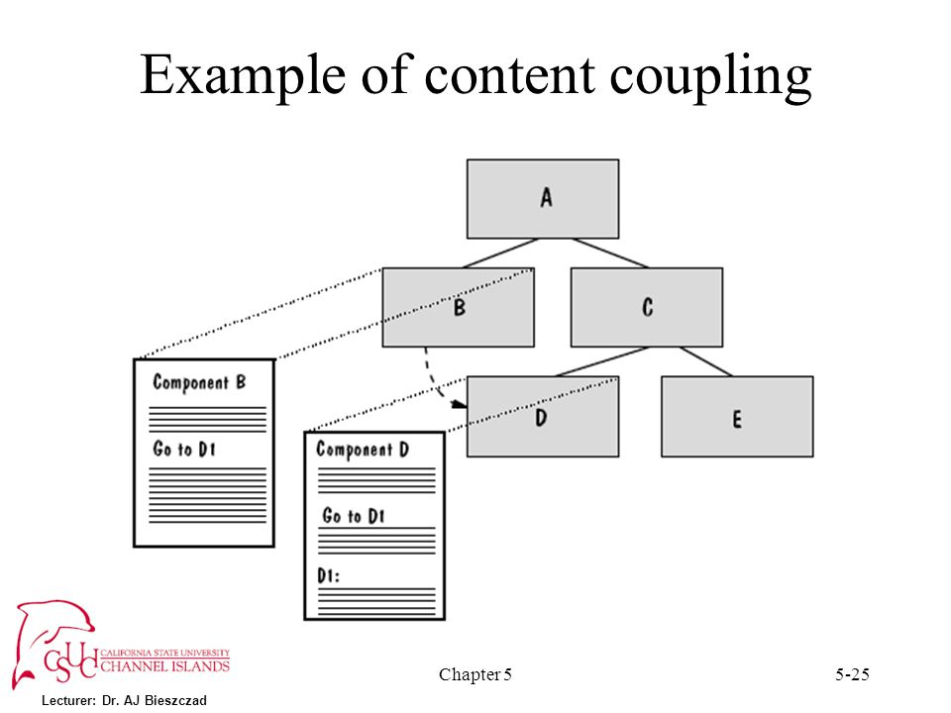
CONTENT COUPLING
In a content coupling, one module can modify the data of another module or control flow is passed from one module to the other module.
This is the worst form of coupling and should be avoided.

Slide 15
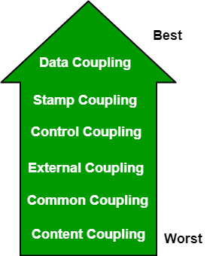
BEST AND WORST COUPLING

Slide 16
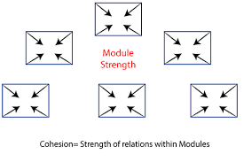
COHESION
Cohesion is a measure of the degree to which the elements of the module are functionally related. It is the degree to which all elements directed towards performing a single task are contained in the component.
A good software design will have high cohesion.
Cohesion is an ordinal type of measurement and is usually described as “high cohesion” or “low cohesion”.

Slide 17
TYPES OF COHESION
Functional Cohesion.
Sequential Cohesion.
Communication Cohesion.
Procedural Cohesion.
Temporal Cohesion.
Logical Cohesion.
Coincidental Cohesion.

Slide 18
FUNCTIONAL COHESION
Every essential element for a single computation is contained in the component.
A functional cohesion performs the task and functions. It is an ideal situation.

Slide 19
SEQUENTIAL COHESION
An element outputs some data that becomes the input for other element. i.e., data flow between the parts.
It occurs naturally in functional programming languages.

Slide 20
COMMUNICATION COHESION
Two elements operate on the same input data or contribute towards the same output data.
Example- update record in the database and send it to the printer.

Slide 21
PROCEDURAL COHESION
Elements of procedural cohesion ensure the order of execution.
Actions are still weakly connected and unlikely to be reusable.
Example - calculate student GPA, print student record, calculate cumulative GPA, print cumulative GPA.

Slide 22
TEMPORAL COHESION
The elements are related by their timing involved.
A module connected with temporal cohesion all the tasks must be executed in the same time-span.
This cohesion contains the code for initializing all the parts of the system. Lots of different activities occur, all at unit time.

Slide 23
LOGICAL COHESION
The elements are logically related and not functionally.
Ex- A component reads inputs from tape, disk, and network.
All the code for these functions is in the same component. Operations are related, but the functions are significantly different.

Slide 24
COINCIDENTAL COHESION
The elements are not related(unrelated). The elements have no conceptual relationship other than location in source code.
It is accidental and the worst form of cohesion.
Ex- print next line and reverse the characters of a string in a single component.

Slide 25
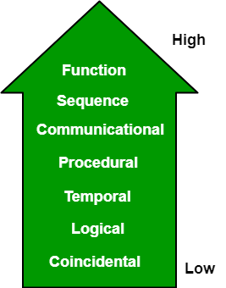
HIGH COHESION AND LOW COHESION

Slide 26
REAL TIME APPLICATION IN COHESION
Cohesion is a leading Intelligent Buildings software solution that is disrupting how buildings operate and how people engage with buildings from real estate owners, operators, building engineers, to tenants and visitors.
Drawing from a real-life example: there would be a thousand things in your home. But if asked to fetch your tennis racket, you can get it in a matter of minutes, if not seconds. If you are asked to get a cooking utensil, you immediate go the kitchen. How is it that you are able to retreive things quickly? Because you have organized them in a highly cohesive way. You have put all the related things together. That is cohesion at play in real life.

Slide 27
THANK YOU

